Slide 1
Big Data Architecture and Governance
Group Project – Team 4
Apoorva Mishra, Atulya Sharma, Dhruv Panchal

Slide 2
Problem Statement
To analyze “Consumer_Complaints” dataset and to build an analytical dashboard as a proof-of-concept to illustrate the value of data driven analytics.
This dataset is primarily meant for Consumer Financial Protection Bureau who has a job of protecting consumers in the financial sector.

Slide 3
Objectives
Creating a Project about Consumer Complaints on Velero ETP
Vision Diagram for Consumer Complaints
Data Profiling, Wrangling and Cleansing.
Neo4j Database Installation
Data Mapping and Integration using Neo4j
Developing Business and Technical Metadata
Data Validation and Visualization using Python
System Integration and User Acceptance Testing
Risks/Issues
Challenges Encountered
End User Instructions

Slide 4
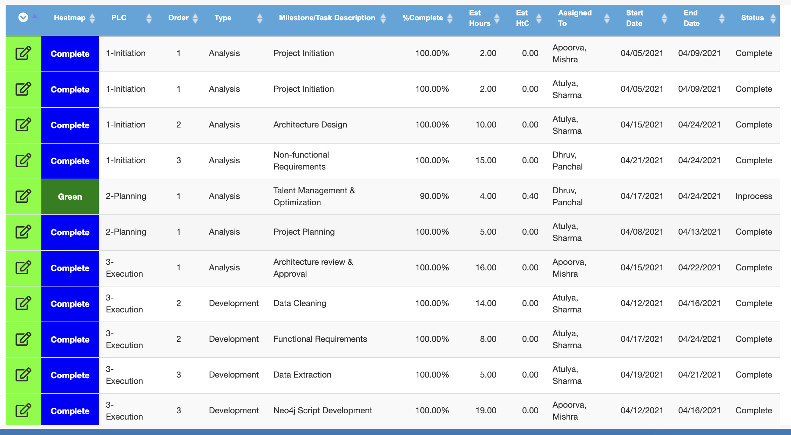
Velero
Milestones/ Tasks

Slide 5
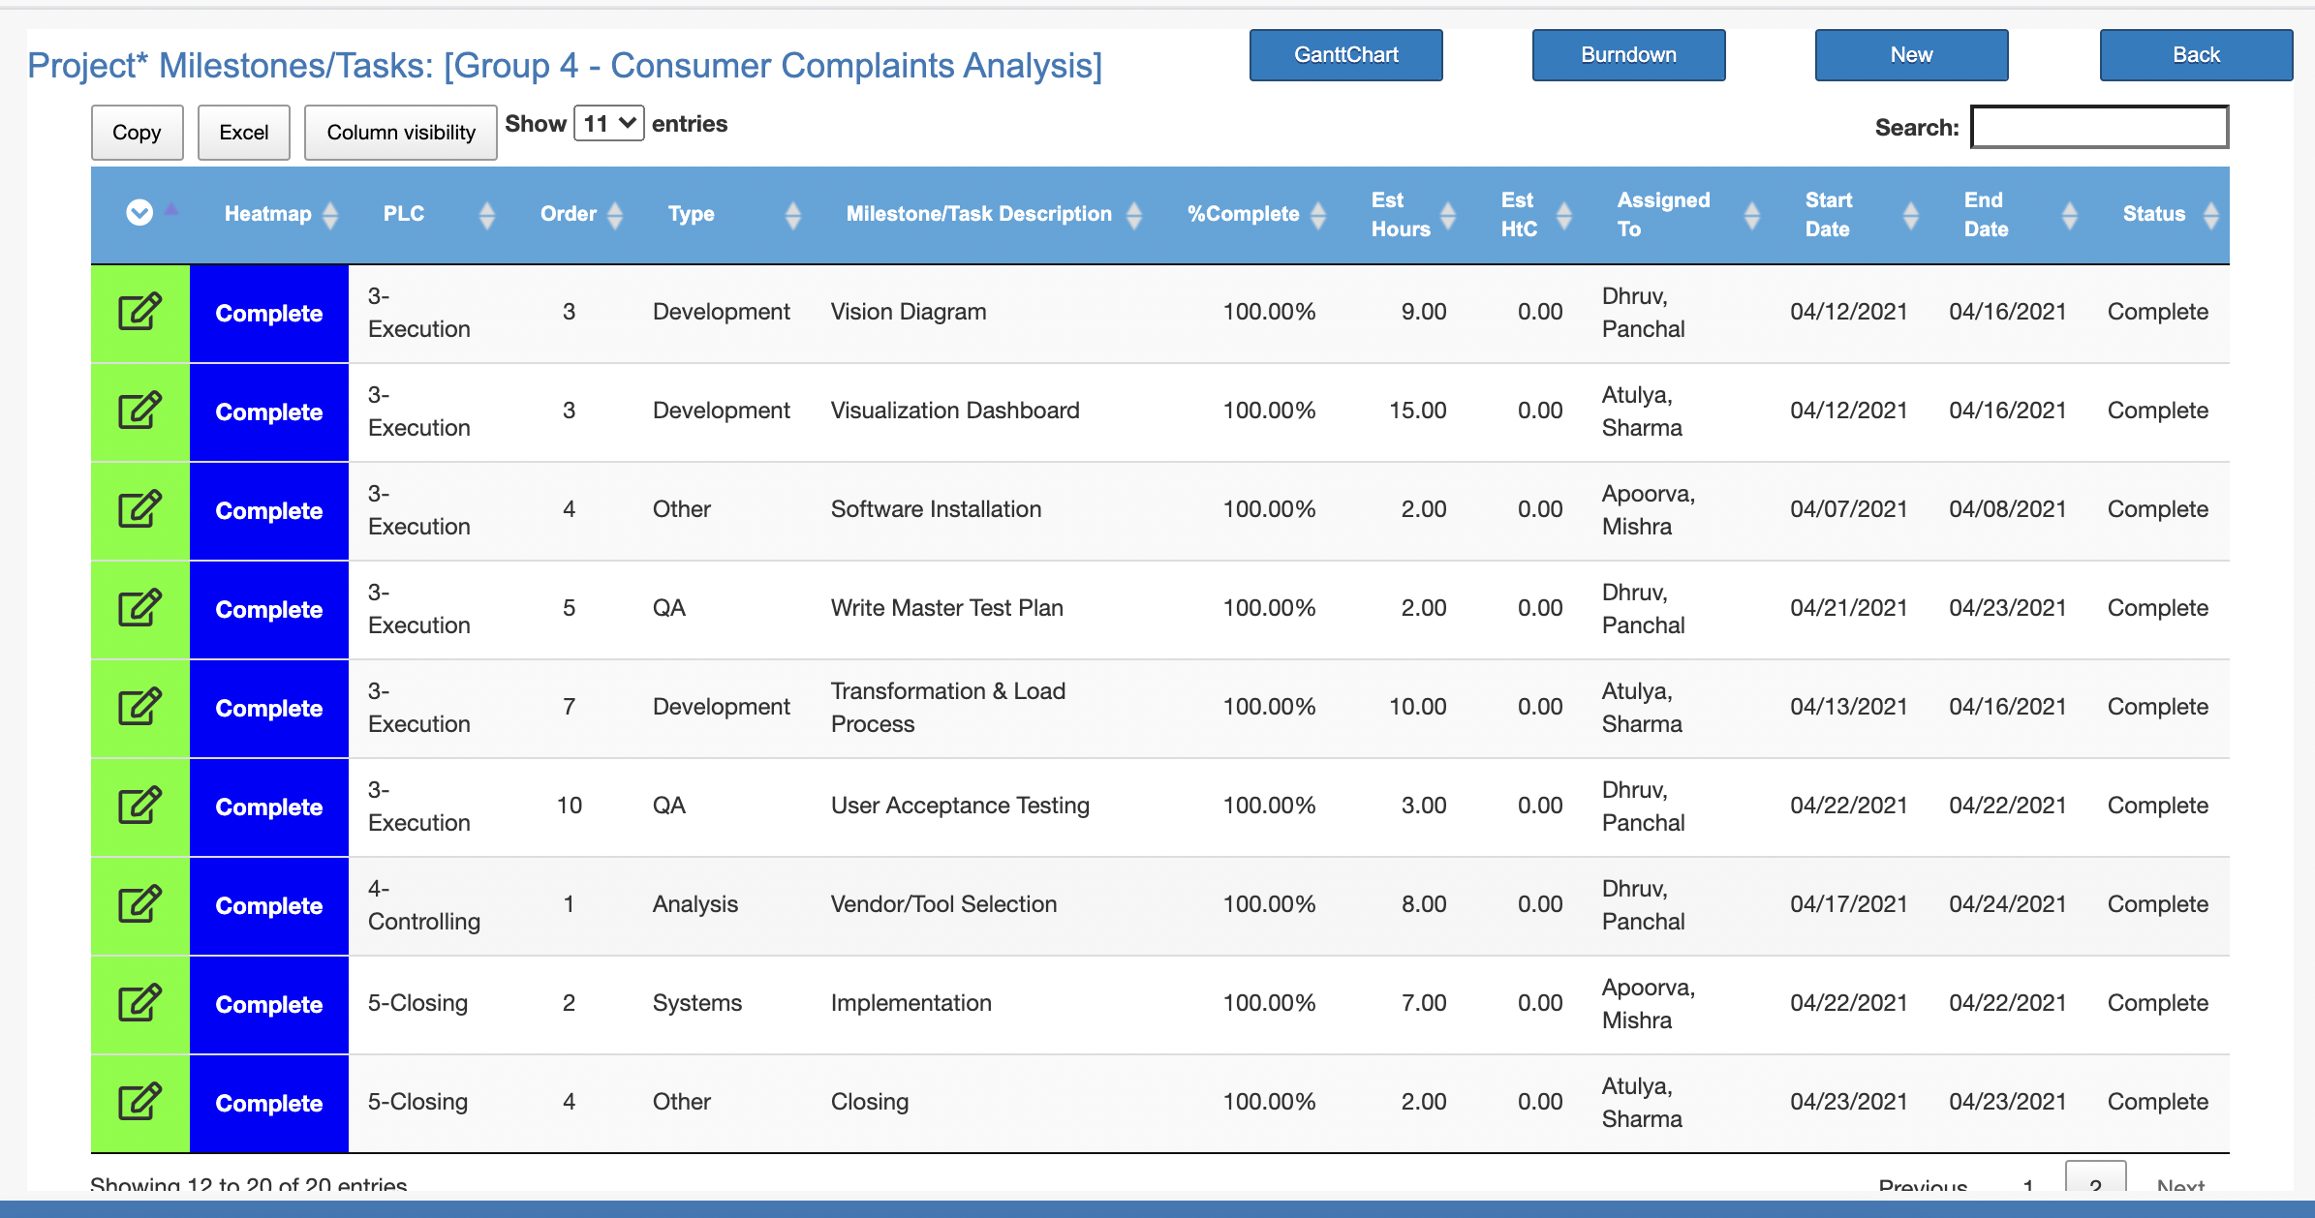

Slide 6
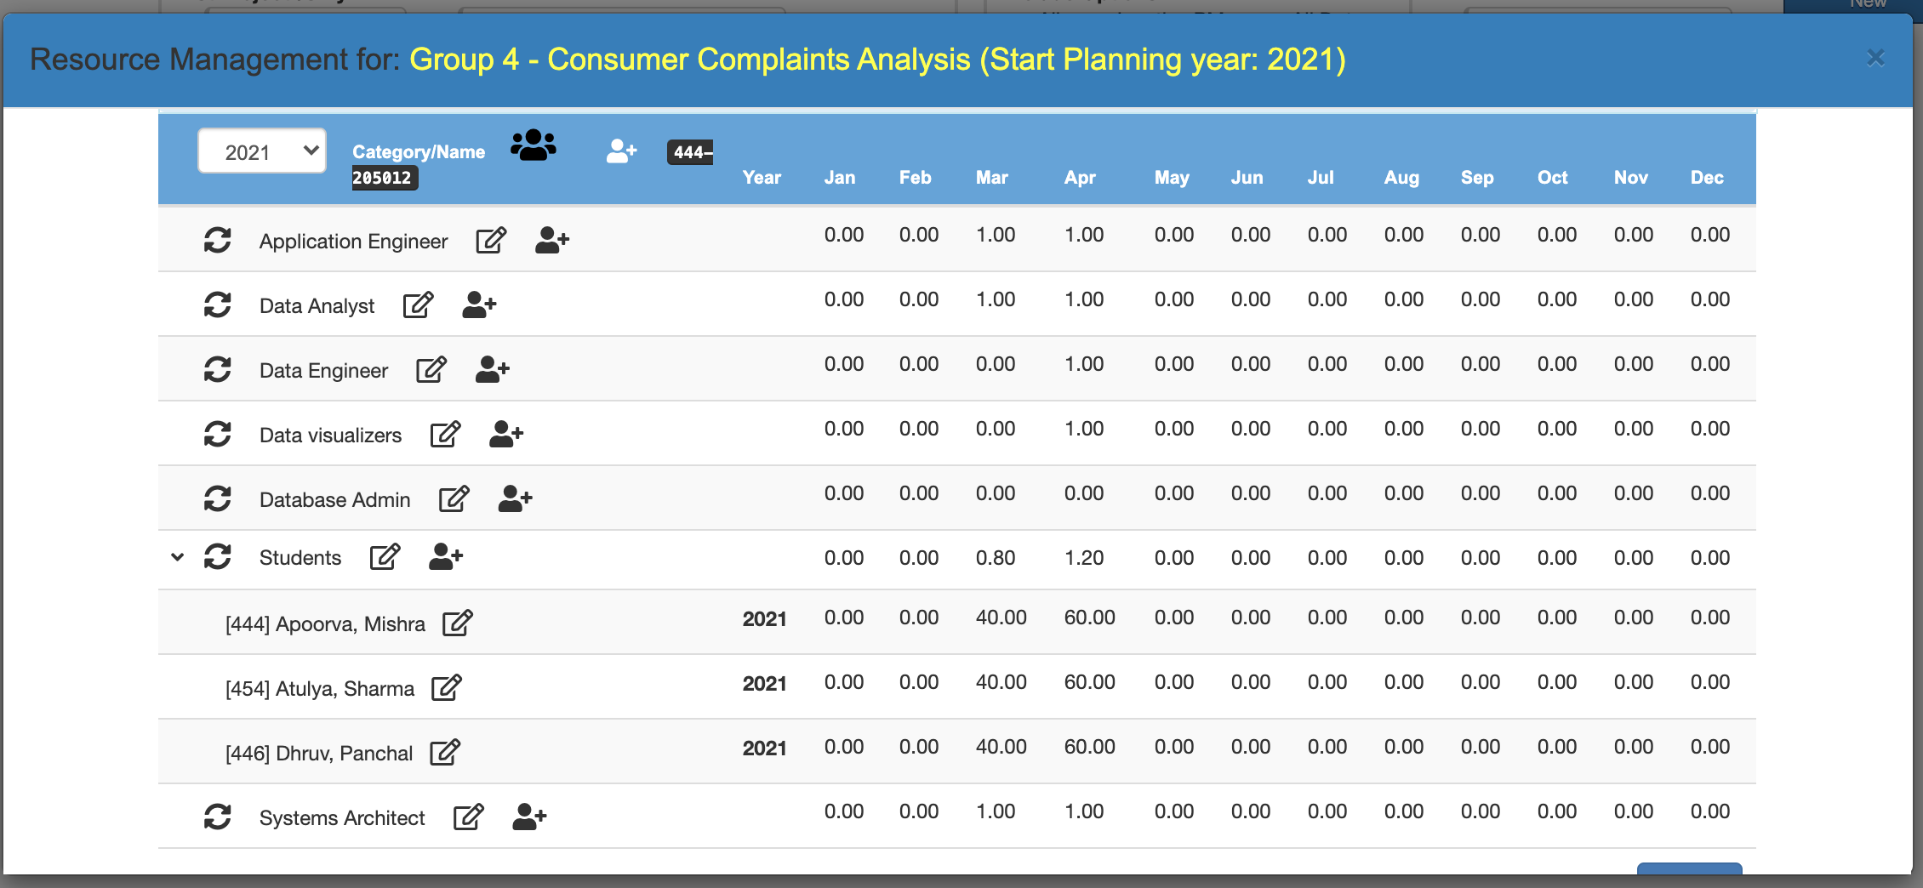
Resource Planning

Slide 7
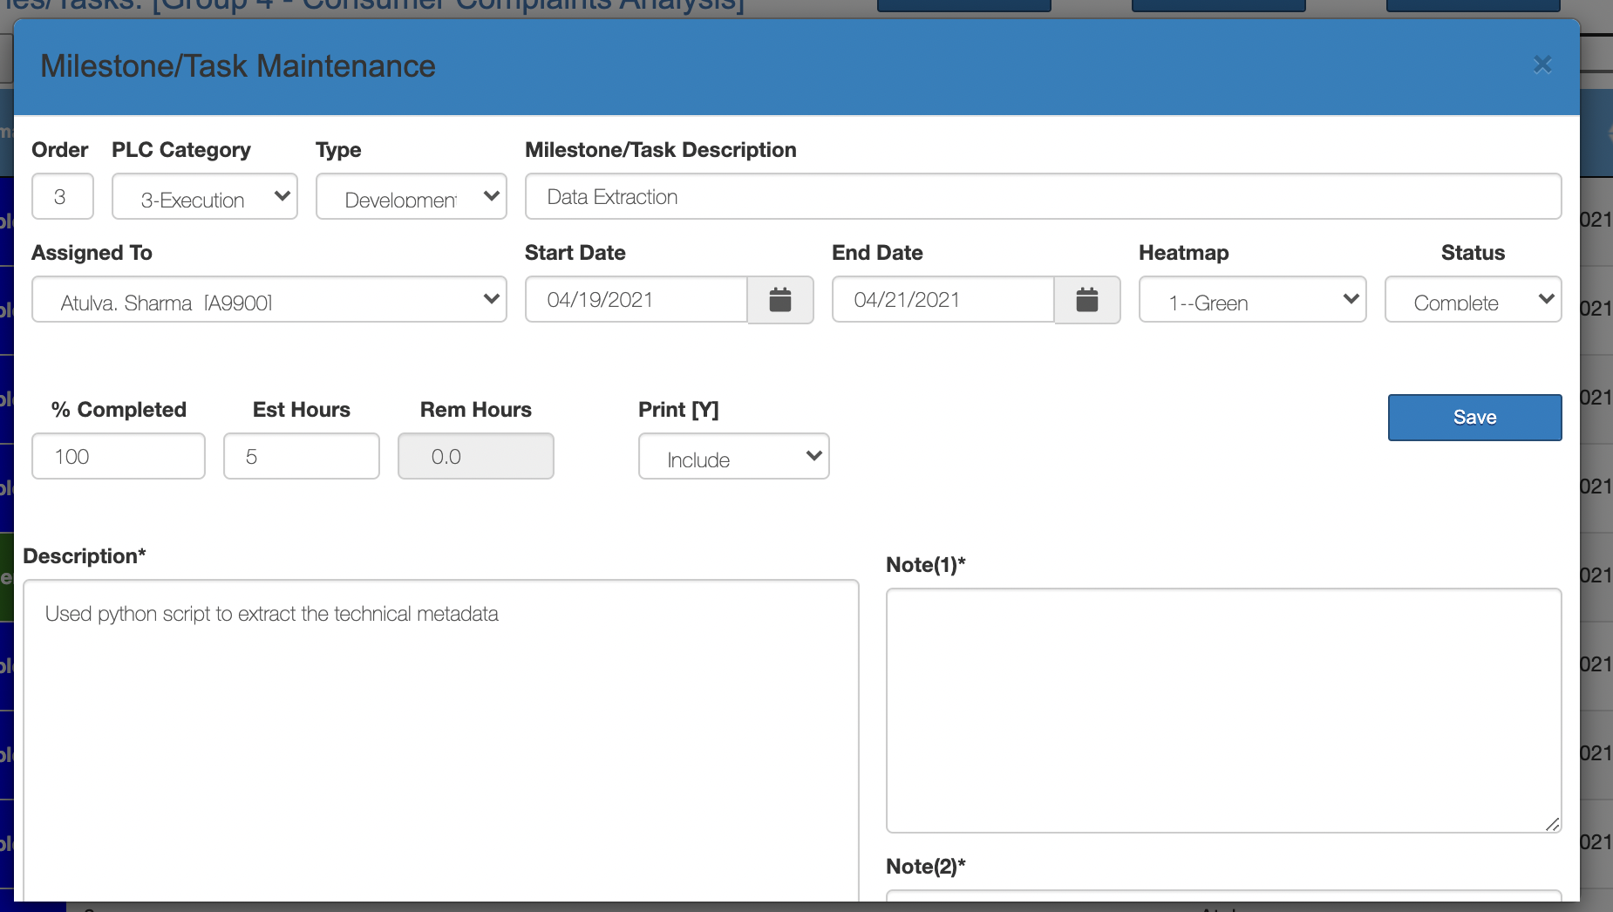
Milestones/Tasks

Slide 8
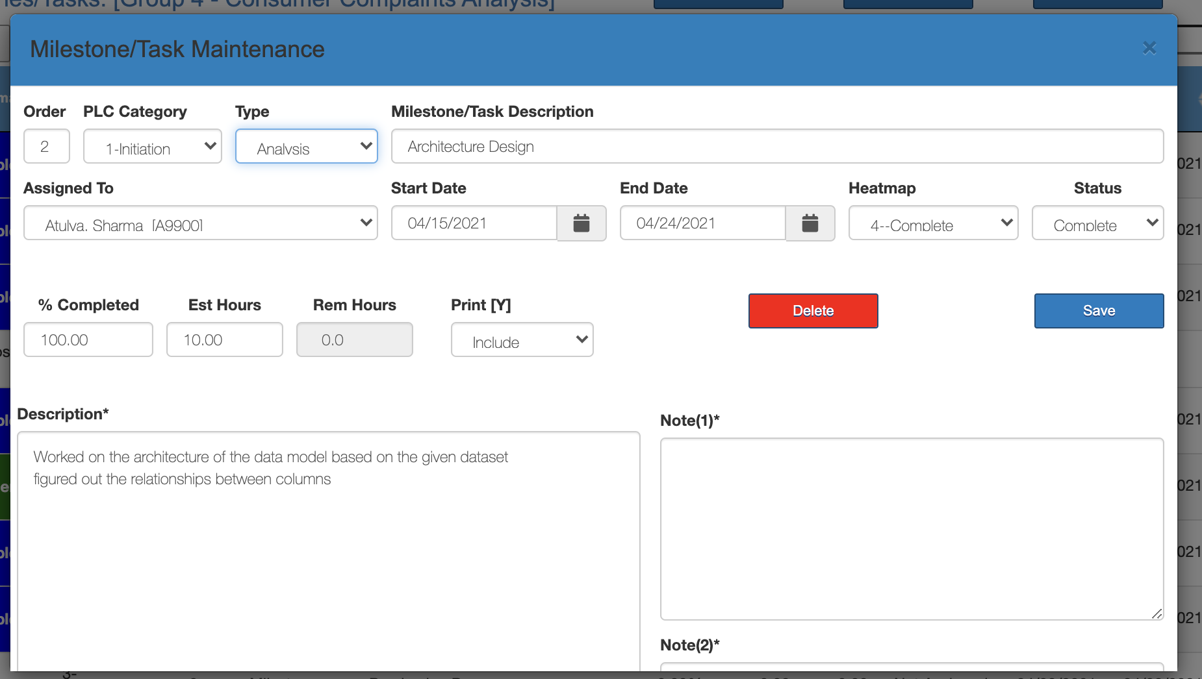

Slide 9
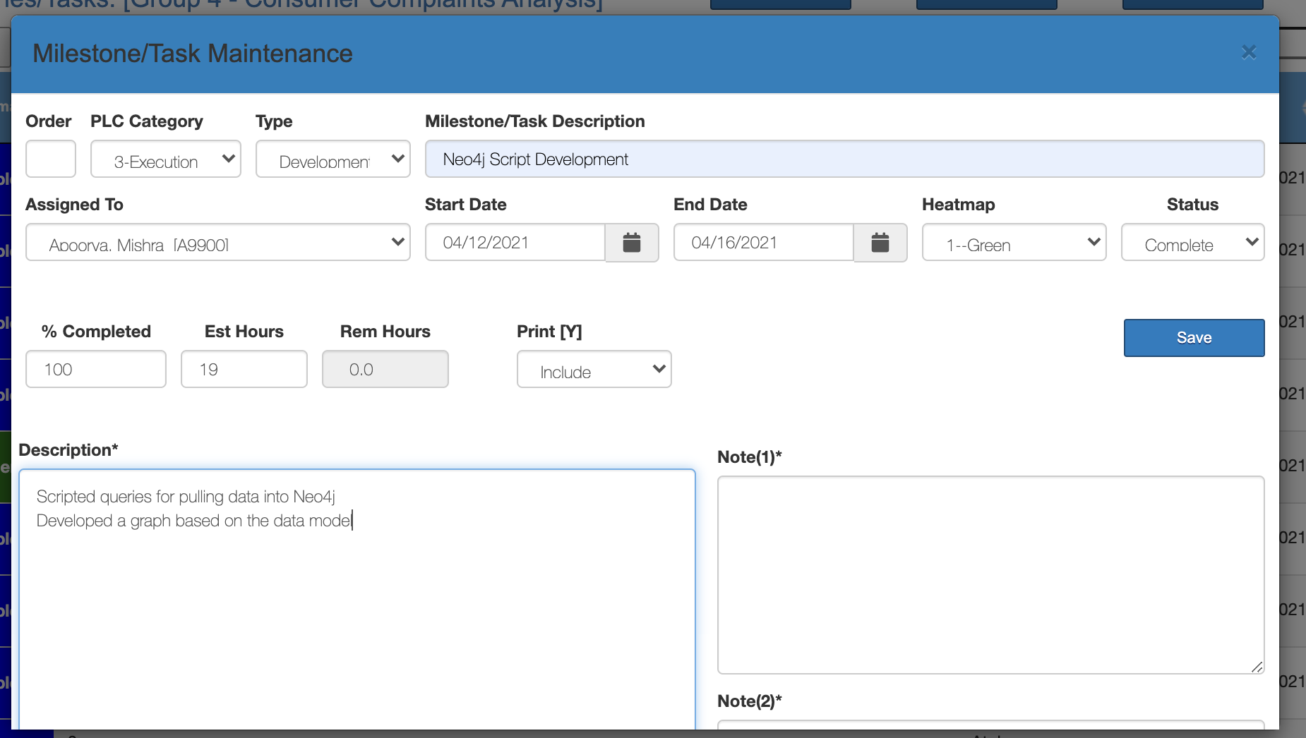

Slide 10
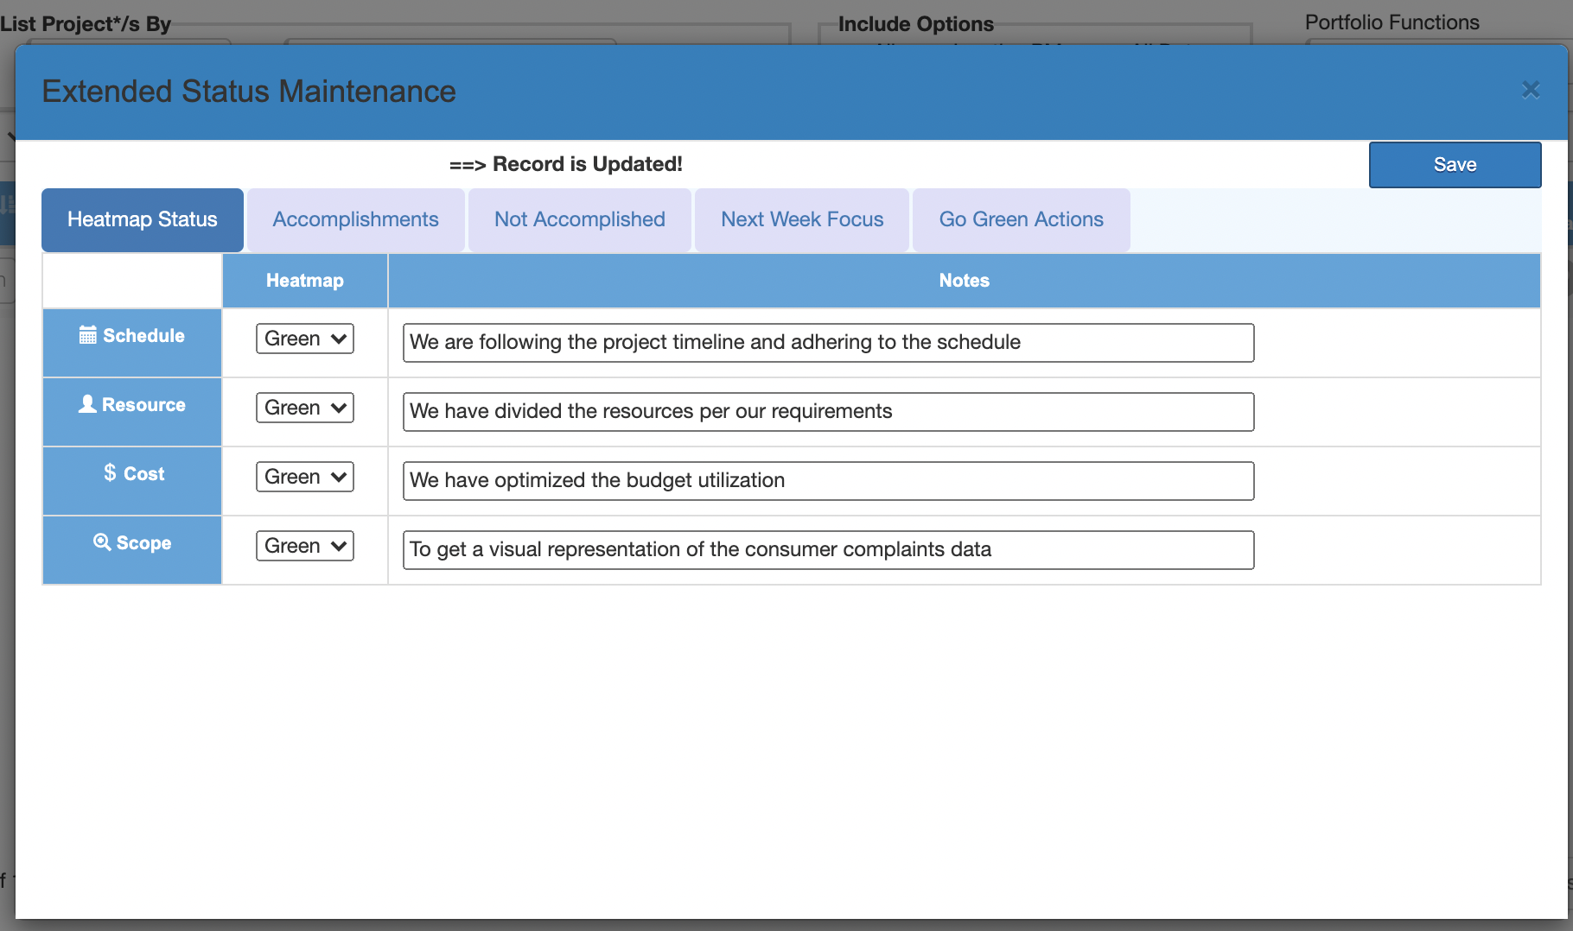
Heat Map

Slide 11
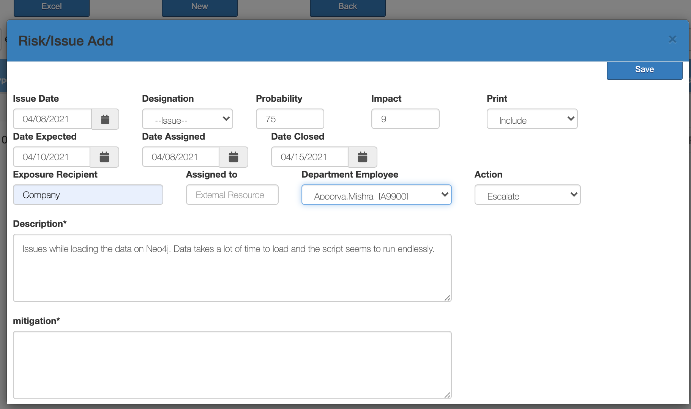
Issues/Risks

Slide 12
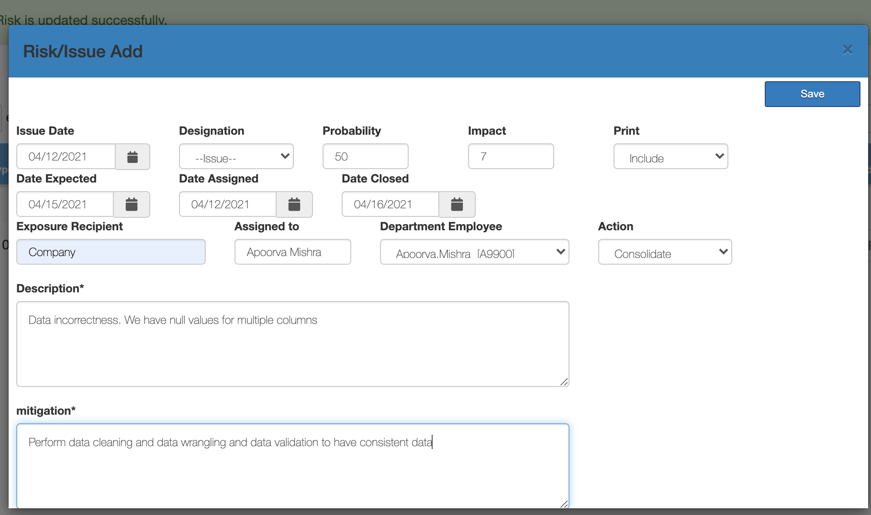

Slide 13
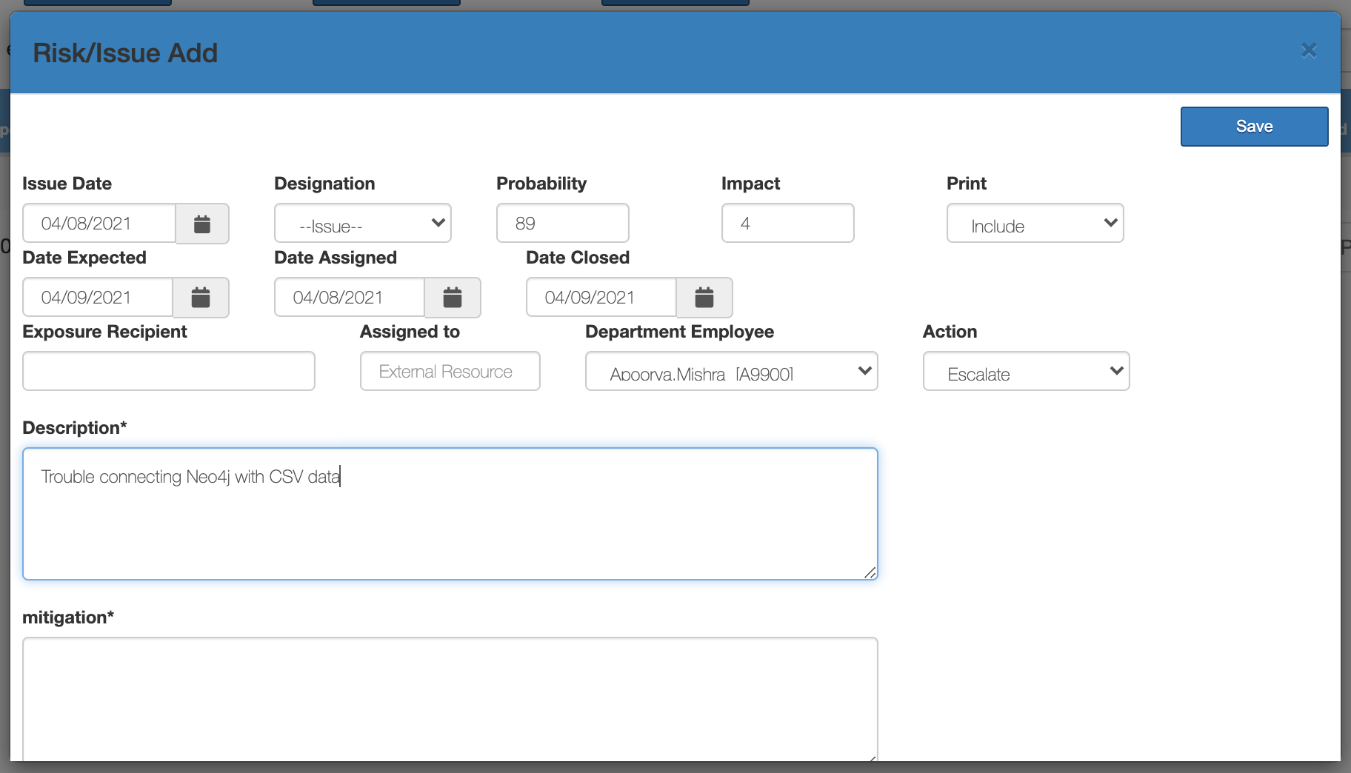

Slide 14
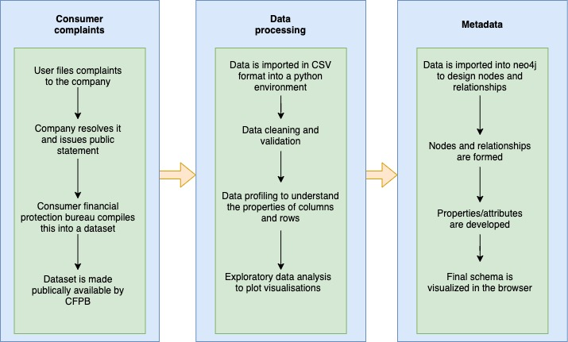
Vision Diagram

Slide 15
Dataset
The dataset consists of complaints about consumer financial products that were sent to the respective companies to get resolved.
The Initial Dataset consisted of 670,598 Rows and 18 Columns.
The timeframe for this dataset is between 2011 and 2016
Link: Consumer_Complaints_Dataset

Slide 16
Dataset Description
The following is the description of few of the columns for the consumer complaints dataset:
Date received: The date on which the complaint was received.
Product: The financial service for which the complaint was registered.
Sub-Product: The financial service within the Product.
Issue: Issue that the customer was facing.
Sub-issue: More granular than issue.
Consumer Complaint: The actual complaint.
Company public response: Response given by the company to the public.
Company: Company Name against which the complaint was filed.
State: State where the complaint was filed.
Complaint ID: The ID generated uniquely for each complaint filed.

Slide 17
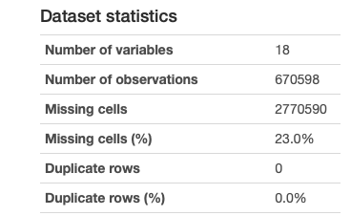
Data Profiling
The Initial Dataset was loading on python and then with the help of Pandas Profiling Library, a report was generated describing the dataset.

Slide 18
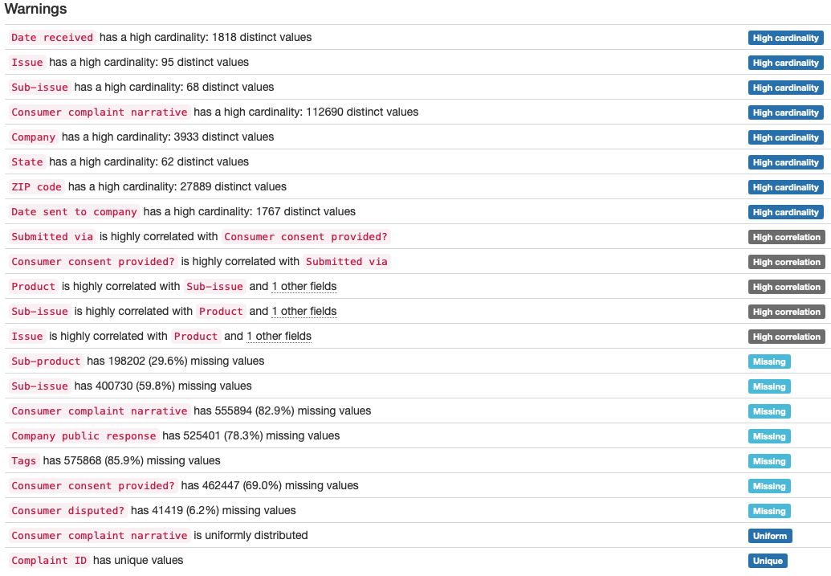
Data Profiling
For the initial data, we find that a lot of columns have high cardinality (variation in values).
Also, Complaint ID is the only column with all values being unique.
Finally, the dataset contains a lot of missing values.
Link: Initial Data Profiling Report

Slide 19
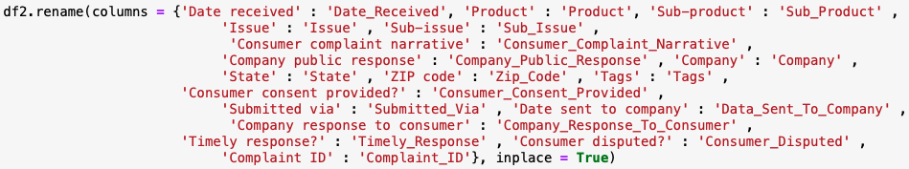
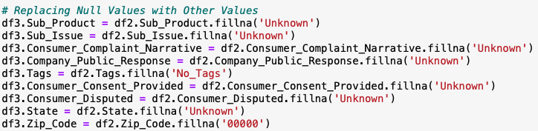
Data Wrangling/Cleaning
The Dataset was first loaded to Python using Pandas library.
Followed by renaming the columns and handling null values.

Slide 20
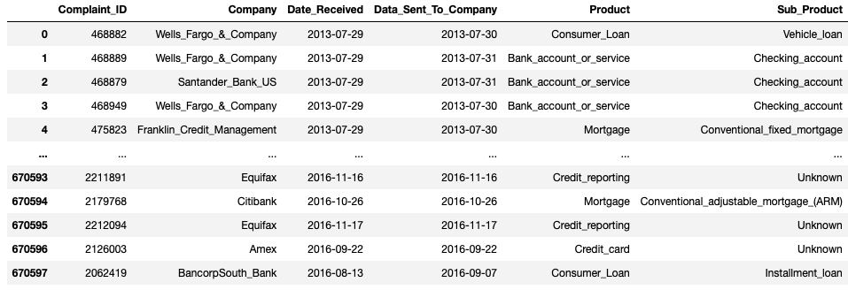
Data Wrangling/Cleaning
Reordering the columns.
Changing the data types
Final Data dataset

Slide 21
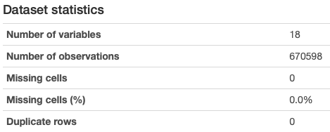
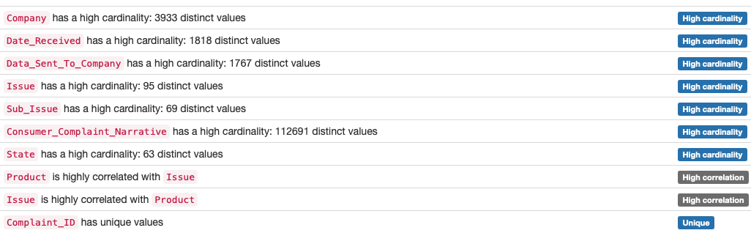
Post Cleansing Data Profiling
The final data set has the following statistics after it has been cleansed.
After Cleansing the data, we see that there are no missing values in the data set. However, multiple columns still have high cardinality.
Link: Post Data Cleansing Report

Slide 22
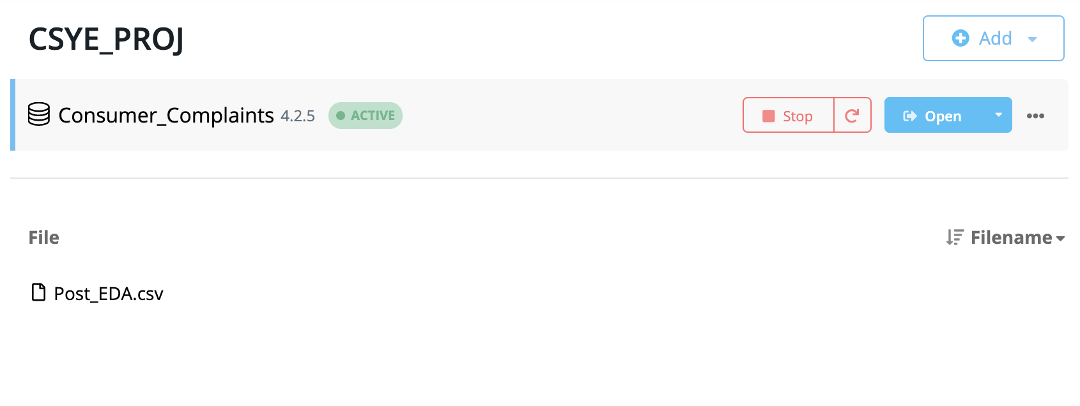
Database Installation
Neo4j is a NoSQL Graph database that uses Cypher Query Language to perform operations on the data that is being loaded.
In order to get the dataset loaded, we have created a project “CSYE_PROJ”.
A database “Consumer_Complaints” is then created under this project.

Slide 23
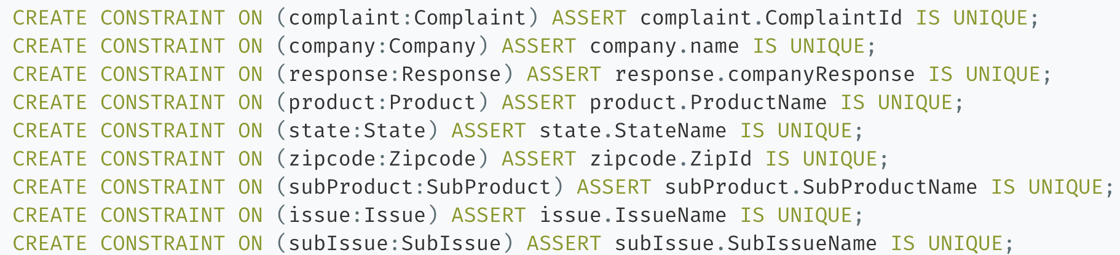
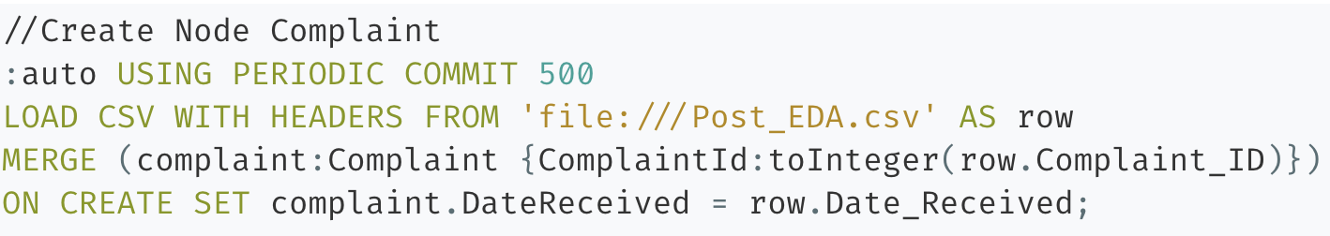
Data Mapping and Integration
After the database is installed and the dataset is added to the “Import” folder, the database is started, and a Neo4j Browser is opened.
We initially create constraints from the dataset followed by creation of our first node “Complaint” along with its properties.

Slide 24
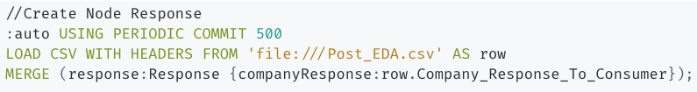
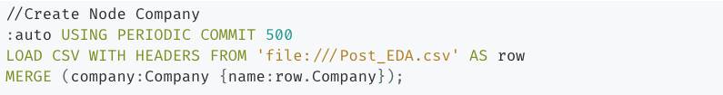
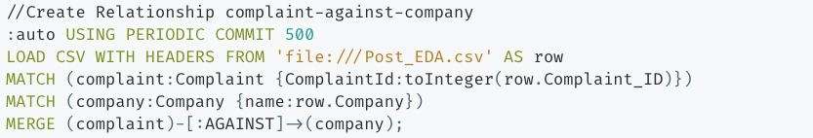
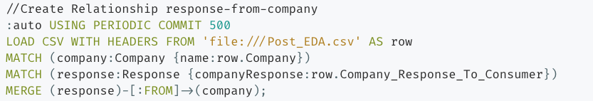
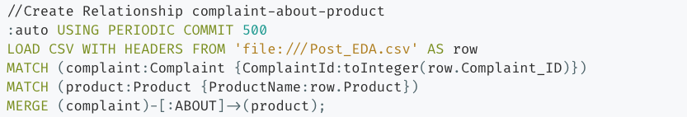
Data Mapping and Integration
Subsequently, all the other nodes like, ”Company”, “Response” and “Product” are created.
Relationships between nodes are then generated using the script shown below.

Slide 25
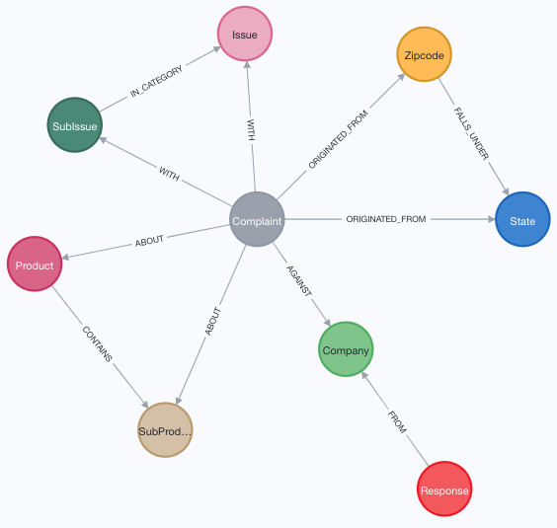
Data Mapping and Integration
Visual representation of the database in the form of a schema is the final step for data mapping and integration.
We have 9 Nodes and 11 Relationships extracted from the dataset.

Slide 26
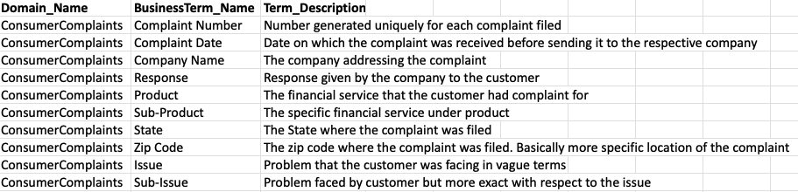
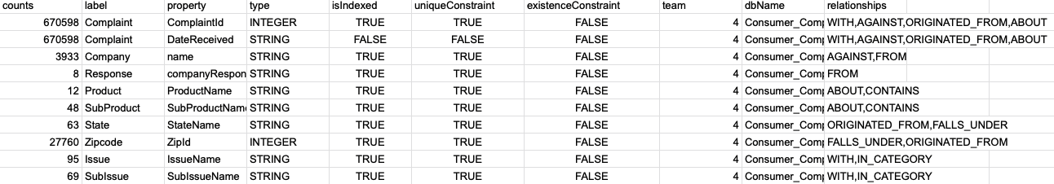
Business & Technical Metadata
Business Metadata
Technical Metadata

Slide 27
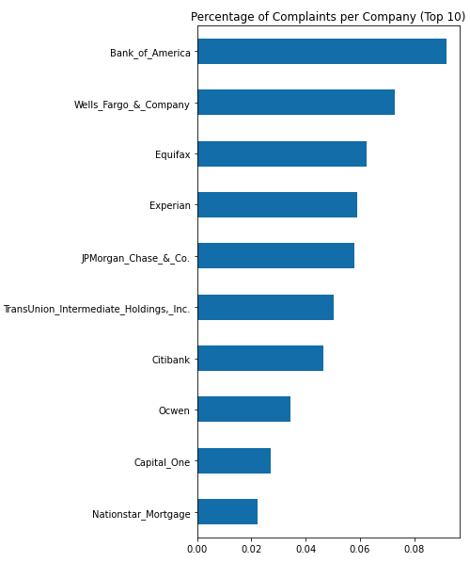
Data Validation and Data Visualization
Following plots represent the dataset and aid to the analysis.

Slide 28
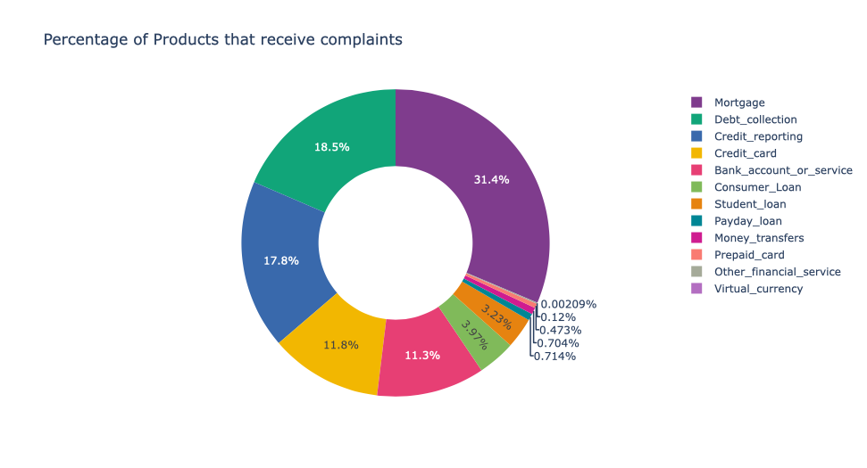
Data Validation and Data Visualization

Slide 29
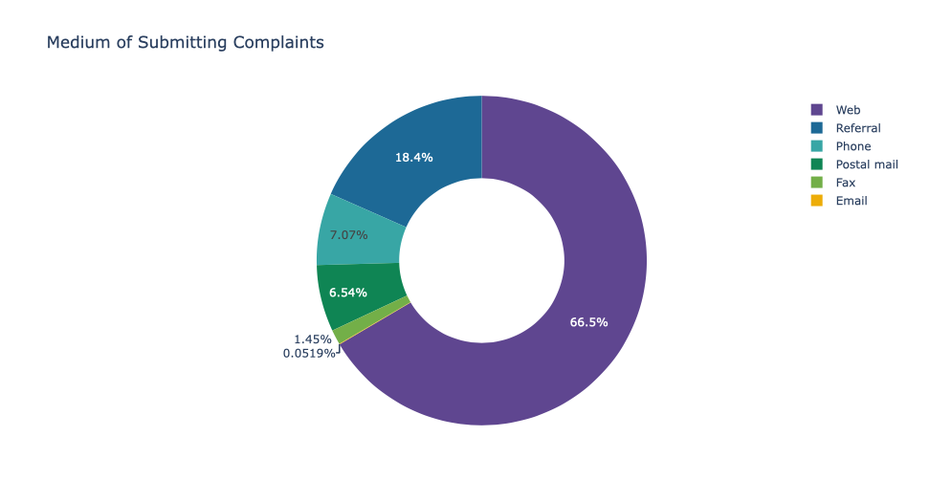
Data Validation and Data Visualization

Slide 30
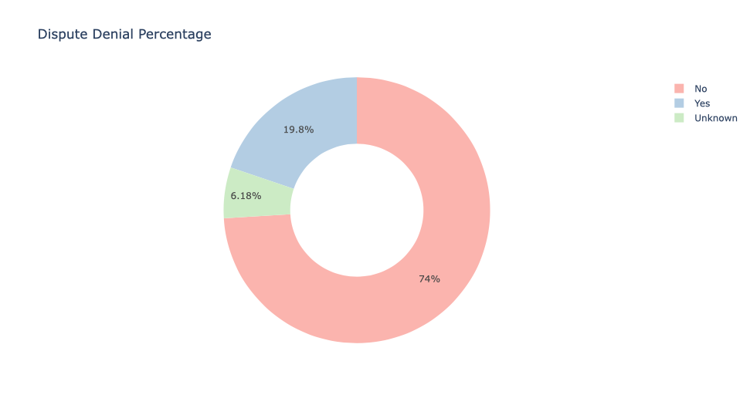
Data Validation and Data Visualization

Slide 31
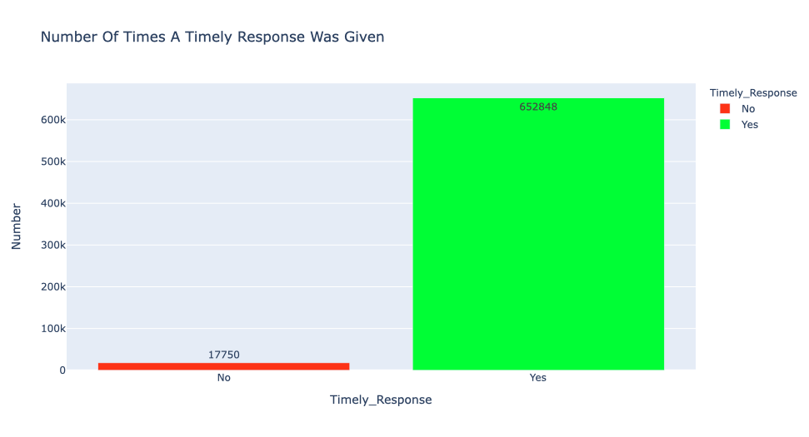
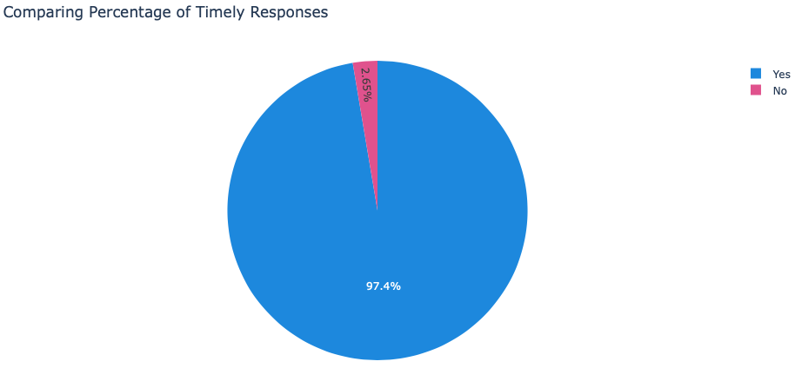
Data Validation and Data Visualization

Slide 32
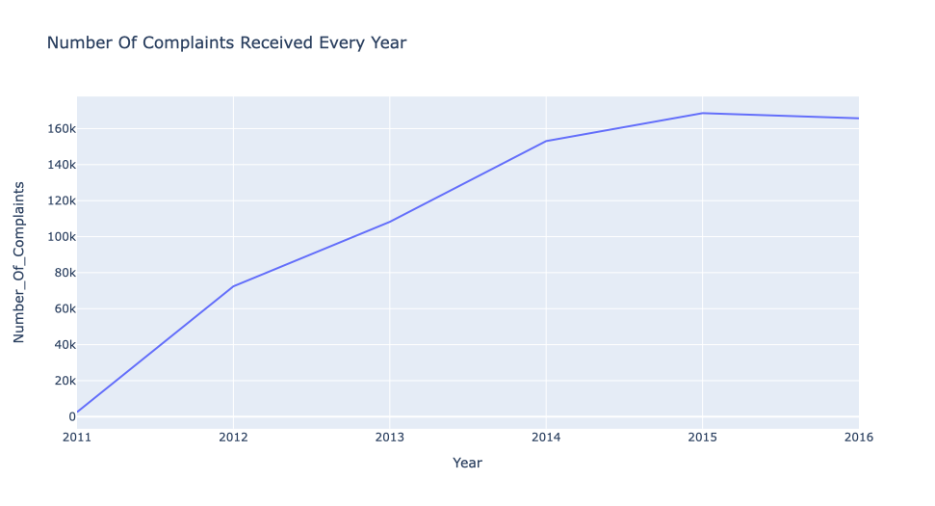
Data Validation and Data Visualization

Slide 33
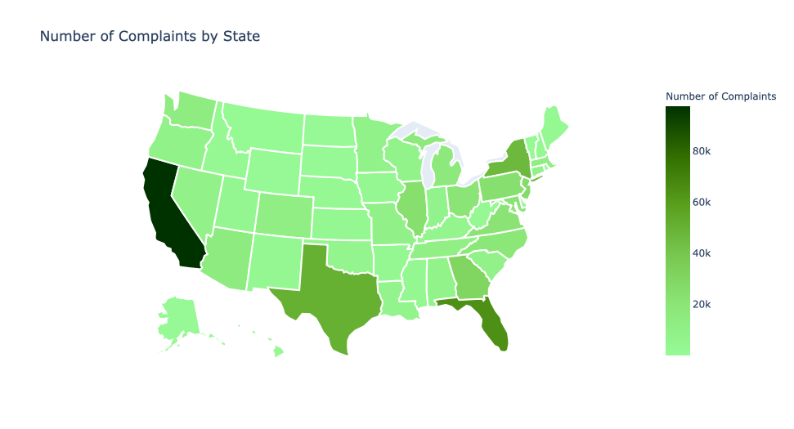
Data Validation and Data Visualization

Slide 34
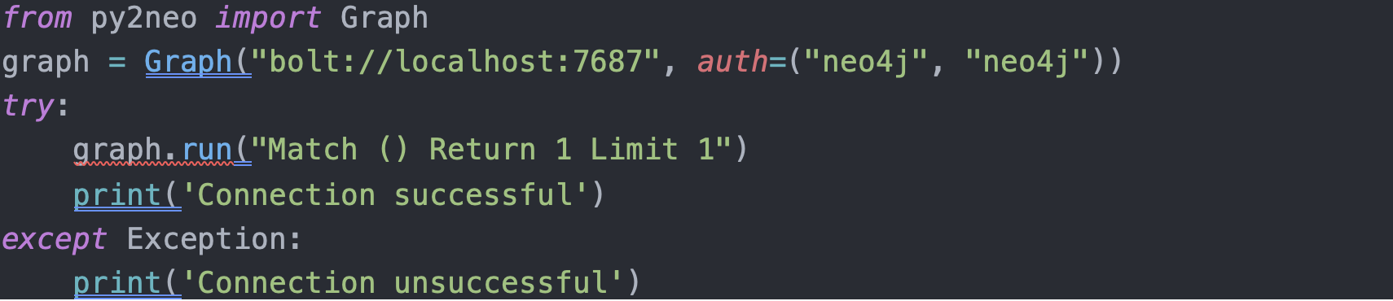
System Integration & User Acceptance Testing
System integration was tested prior to ingesting data in the database.
The following piece of code was run to validate system connection. The py2neo is the package. It is open source and available to download using the PIP package manager.
The neo4j is running on localhost and the authentication is passed as parameter.
We connect to the database and send a query which if runs without error means the database is connected.
Upon no error we print Connection Successful
If the code returns some error we say the Connection Unsuccessful

Slide 35
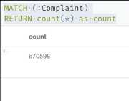
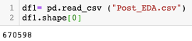
For integration testing, we test the contents of both the input file and the data inserted in the database.
For Data validation we check the count of the rows of data in the neo4j database and the python script used for EDA.
The following is the output for the neo4j row count query.
The match statement is used to match all the rows in the Complaint column, and we return the count of rows.
Count of all rows was cross verified with the input csv file using Python.
This concludes integration testing

Slide 36
User acceptance testing
User Acceptance Testing, also known as UAT testing means A process of verifying that a solution works for the user.
The ideal workflow will ideally be a user entering the data and it will successfully get inserted into the database.
The issue that could arise in this is the data is either invalid or has inconsistencies.
To validate the user can check the data that is to be inserted in the database using the python script to count the number of rows. Then we use a second script to check the amount of rows in the neo4j.
If the output of both the query and the python code match then we can conclude the application is working perfectly and this concludes user acceptance testing.

Slide 37
Challenges Encountered
The following are the challenges we encountered
Data mapping
Here we had to collectively understand what the data provided to us contained.
We had to understand the relationship between the columns.
Data visualization
For visualization, a new package had to installed to build interactive graphs and plots
Zip code and State relationship had to be built to plot the data on an interactive map
Neo4j
The concepts and inner working of this new database had a learning curve.
The working knowledge of how nodes and relations are built in Neo4j had to be figured out.
New syntax had to me understood to efficiently query the database and insert data into it.

Slide 38
End User Instructions Database Creation and loading
Open Neo4j and create a project, followed by creating a local database.
Load the Post_EDA.csv file to the import folder.
Start and then open the database.
Create constraints followed by nodes and relationships.
Visualize the schema.

Slide 39
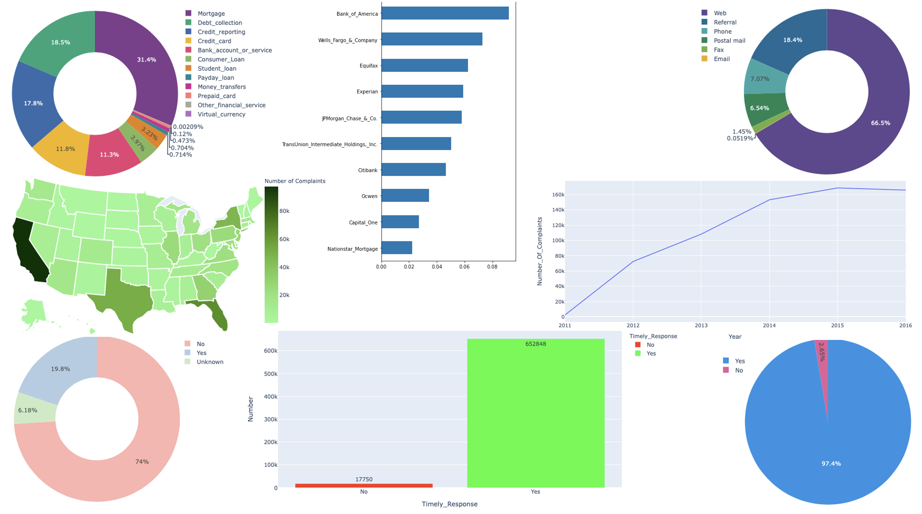
% of Products that receive complaints
Top 10 Companies with max complaints
Medium of submitting complaints
Dashboard View
Number of complaints each year
Dispute Denial
Timely Response given by the company

Slide 40
End User Instructions
This Dashboard can help consumers decide the products and services that they should avail, considering the number of complaints received.
It can also help CFPB keep a check on certain states to reduce the number of complaints in the future.
Looking at the number of complaints increasing every year, consumer should be very careful before investing in the financial domain.
The CFPB can inspect the companies with the maximum number of complaints and investigate.
The end user apart from the CFPB can be any interested person, by looking at the Product, State and the Company before making any decisions. If the state that the person lives in has a lot of complaints, the use needs to be more careful.

Slide 41
End User Instructions
Tha data cleaning/wrangling and data validation has been done in python on the given data set. Use python script as provided in the files.
Neo4j is used with csv files and to generate the graph database displaying the nodes and the relationships. We have a Neo4j Script to load data from csv to the database.
Python Visualizations for building the dashboard.

Slide 42
Thank you!!!

